Slide 1
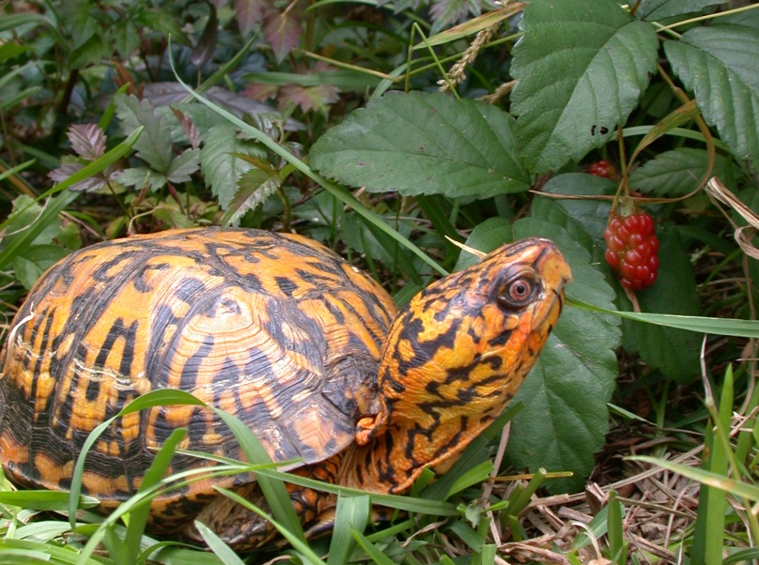
Don’t Take Me Away From My Own Home
Let Box Turtles Stay Wild!

Slide 2
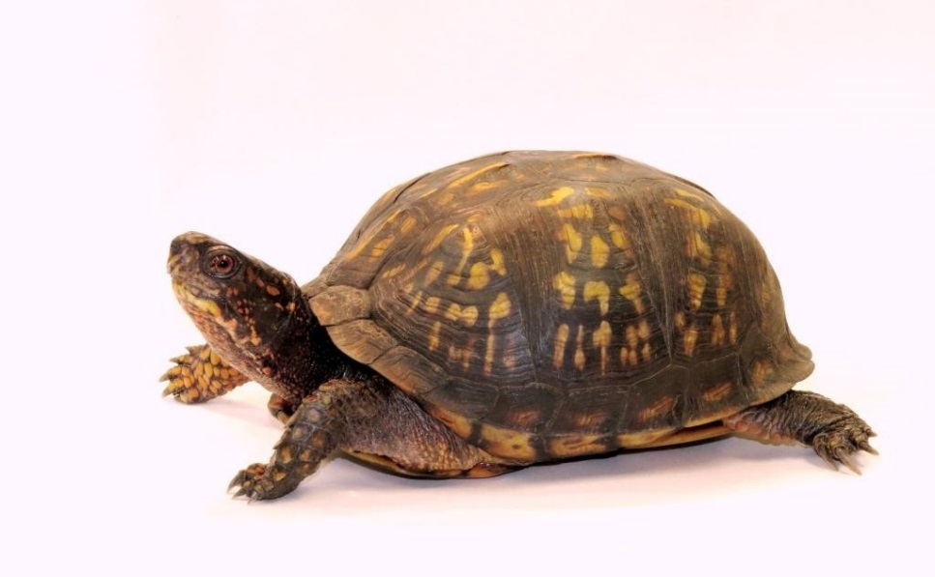
Box Turtles Are in Trouble
Turtles on the Road
Eastern Box Turtles (Terrapene carolina carolina) are North Carolina’s state reptile. Their numbers are dwindling, in part because people move them to a new place or take them home as pets. It may be just one here or there, but the result is thousands of box turtles disappearing from their forest and field homes, forever.
If you see a turtle crossing the road, move it to the side that it is headed towards. Resist the urge to drive it to a “safer” place. Remember - that turtle may have been living there for decades, already knows where to find food and mates, and has a special place to hibernate or lay eggs. Watch out for vehicles when helping turtles. Don’t take risks with your own life!
They Need to Stay Wild
As far as nature is concerned, a turtle taken from the wild is “dead.” It can no longer help maintain the population. “Saving” or “helping” a turtle by bringing it home or moving it to a new location in fact hurts fragile turtle populations. Moved from its home in the wild, a box turtle may sicken and die and pose a health threat to recipient populations. Turtles released into unfamiliar surroundings (sometimes called relocation) are often killed by predators or crushed by cars as they attempt to return to their original wild homes.
Help Wild Box Turtles
Adults and children can help wild box turtles. Report your turtle observations and other reptiles and amphibians to the Carolina Herp Atlas:
www.carolinaherpatlas.org
Above: Female Eastern Box Turtle by J.C. Beane
Cover Photo: Male Eastern Box Turtle by J.D. Willson
theherpproject.uncg.edu
boxturtle.uncg.edu
theherpproject.uncg.edu

